Slide 1
Data Mining for Business
Introduction to Machine Learning and Data Mining
Lecture 1
Dr. Kamesam

Slide 2
Exams, HW Assignments and Project
Mid-term Exam (5th November) 30%
Class Participation + Attendance 5%
Group Project – 2 phases 35%
Home works assignments(6) 30%
Class Participation is Student’s responsibility.
Group Project: Each group to have 3 students.
PLEASE DO NOT use your cell phone or Text in class. Turn off the cell phone

Slide 3
Dr. Kamesam
Ph.D. in Operations Research - Univ. of Wisconsin, Madison
M.S in Operations Research - Univ. of Wisconsin, Madison
P.G. Diploma in O.R. - Indian Statistical Institute, Calcutta
M.S. in Statistics - Indian Statistical Institute, Calcutta
B.S. (Honors) in Statistics - Indian Statistical Institute, Calcutta
Professor at Fordham University from 2012
Experience
28 years at IBM Watson Research Center
Research Scientist/Manager/Senior Mgr/Program Mgr/Associate Director
Professor at Columbia, NYU Business schools, Univ of Maryland
Research : Mathematical Optimization, Information Systems, Text Analytics, Emerging Technology Evaluation

Slide 4
GA and Grading
Name: Hao Lu
Email: hlu57@fordham.edu
GA will grade all HW assignments. Instructor to grade exams and projects.
Questions about HW grading: send email to Hao Lu. If not resolved, come to me or write to me.
Syllabus has approximate due dates for HW. Assignment Due dates will be posted on BB.
Assignments must be submitted as MS Word or pdf files. Please avoid Google Docs etc.

Slide 5
Textbook and Software
Text Book: Tan, Steinback, Karpatne, Kumar, “Introduction to Data Mining”, second edition, Pearson
Data Mining / Machine Learning SOFTWARE
SPSS Modeler 18.0 ( for this course)
SAS
XLMINER
WEKA 3.8 (open source: https://www.cs.waikato.ac.nz/ml/weka/downloading.html)
Rapid Miner (open source)
Apache Mahout (open source)
Data Robot

Slide 6
IBM SPSS Modeler
We will be using a highly rated Machine Learning/ Data Mining software from IBM.
IBM has generously extended a free 6 month license to each student.
You need to install (instructions on BB) SPSS Modeler on your laptops and bring your laptop to class, as needed.
SPSS Modeler installation guide, user guide, algorithmic guide etc. are on Black Board.
Programming knowledge is NOT required.

Slide 7
Data Mining
Data Mining is defined as the process of discovering patterns in data. The process must be (semi)automatic, and patterns discovered must lead to some advantage, usually, an economic advantage.

Slide 8
Origins of Data Mining
Draws ideas from machine learning/AI, pattern recognition, and statistics
Traditional techniques may be unsuitable due to
Enormity of data
High dimensionality of data
Heterogeneous, distributed nature of data
Artificial Intelligence / Machine Learning/
Pattern Recognition
Statistics
Data Mining
Database systems

Slide 9
An example problem: Customer Attrition
TelCo, a major telecommunications firm, wants to investigate its problem with customer attrition, or “churn”
In the mid-Atlantic region, 20% of cell-phone customers leave when their contracts expire
Which customers should they target with a special offer, prior to contract expiration?

Slide 10
The goals for this course
Approach business problems data-analytically
Think carefully & systematically about whether & how data mining can aid business decision making.
Receive hands-on experience mining data
You will use SPSS Modeler. Your learning in this class will enable you to switch to other software/platform quickly.
3. Evaluate Data Mining Algorithms. Draw valid conclusions from data analysis.
Know the basics of data mining processes, algorithms, & systems well enough so you can draw meaningful conclusions

Slide 11
Background in Statistics
The Following background would be very helpful.
The basics of statistical analysis, including statistical hypothesis testing
Basic Probability, Conditional Probabilities
Linear Regression, Multiple Regression
If you forgot – review

Slide 12
Machine Learning
Every company is talking about Machine Learing (ML) and investing in ML projects!!
Machine Learning skills are the most sought after today!!

Slide 13



Google is the Leader in Machine Learning, AI today
Has several thousands of machine learning professionals
Has enormous amounts of data, and Computing power.
Many of the recent advances in Machine Learning came from Google
https://ai.google/
How Google is Remaking Itself as a “Machine Learning First” Company-- Wired Magazine
https://www.wired.com/2016/06/how-google-is-remaking-itself-as-a-machine-learning-first-company/

Slide 14

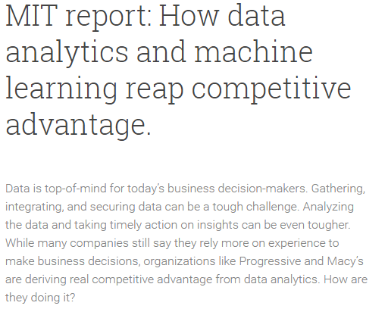

Slide 15
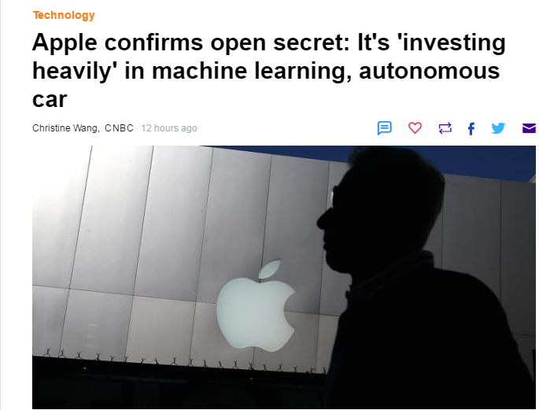
Apple
https://www.zdnet.com/article/apple-says-artificial-intelligence-and-machine-learning-critical-area-as-it-promotes-ai-chief/

Slide 16

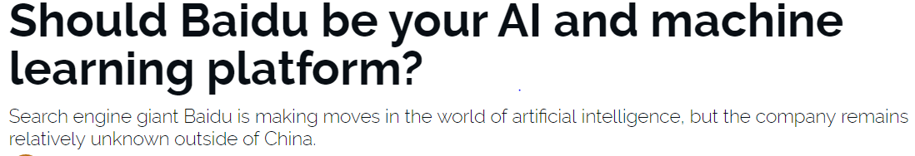
How Chinese Internet Giant Baidu Uses Artificial Intelligence and Machine Learning, Forbes, July 2018
Chinese internet giant Baidu released ‘EZDL’ on September 1. EZDL allows businesses to create and deploy AI and machine Learning models without any prior coding skills, September 1, 2018

Slide 17

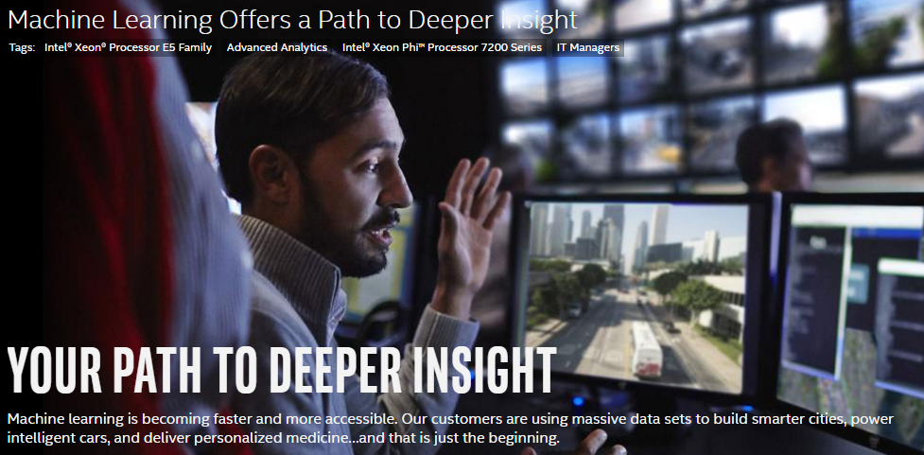

Slide 18
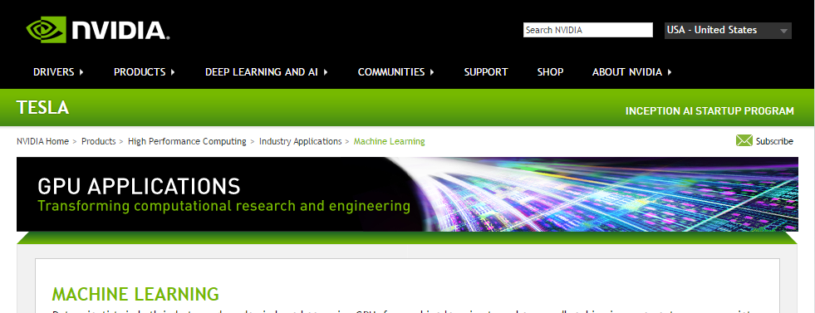
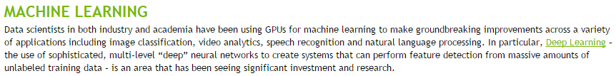

Slide 19
Machine Learning is the next big Technology
“A breakthrough in machine learning would be worth ten Microsofts” (Bill Gates, Chairman, Microsoft)
“Machine learning is the next Internet” (Tony Tether, Director, DARPA)
Machine learning is the hot new thing” (John Hennessy, President, Stanford)
“Web rankings today are mostly a matter of machine learning” (Prabhakar Raghavan, Dir. Research, Yahoo)
“Machine learning is going to result in a real revolution” (Greg Papadopoulos, CTO, Sun)
“Machine learning is today’s discontinuity” (Jerry Yang, CEO, Yahoo)
Notes:
DARPA short for Defense Advanced Research Project Agency

Slide 20
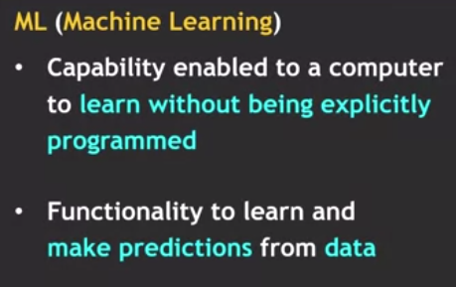
So What Is Machine Learning?
Automating the “automation”
Getting computers to program themselves
Writing software is the bottleneck
Let the data do the work instead!

Slide 21
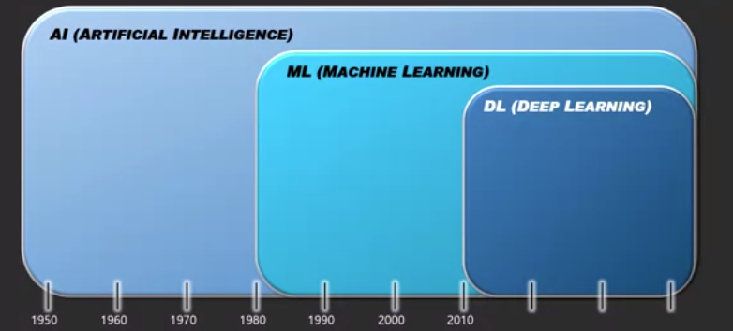
AI, ML, and Deep Learning

Slide 22
Traditional Programming
Machine Learning
Data
Computer
Output
Program
Data
Computer
Program
Output

Slide 23
Some Successful Applications of Data Mining

Slide 24
Successful Applications
Web search
Computational biology
Finance
E-commerce
Space exploration
Robotics
Information extraction
Social networks
Machine Translation
Applications in Finance (https://www.techemergence.com/machine-learning-in-finance)

Slide 25
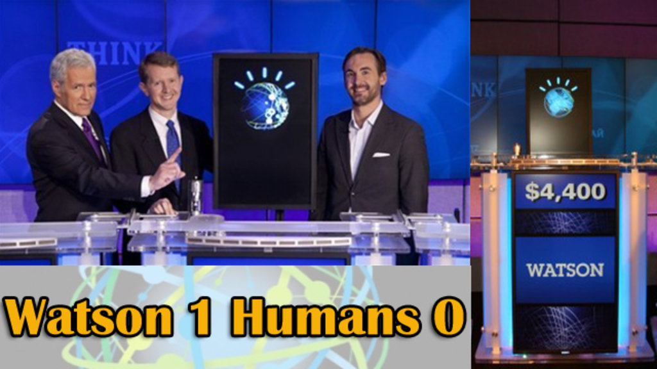
IBM Watson wins Jeopardy
Natural Language Processing + Machine Learning → Beat Grand Champions

Slide 26
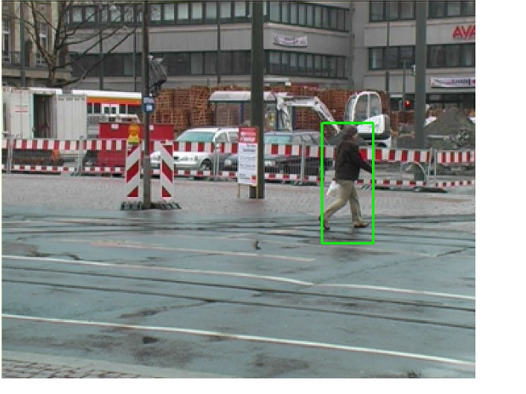
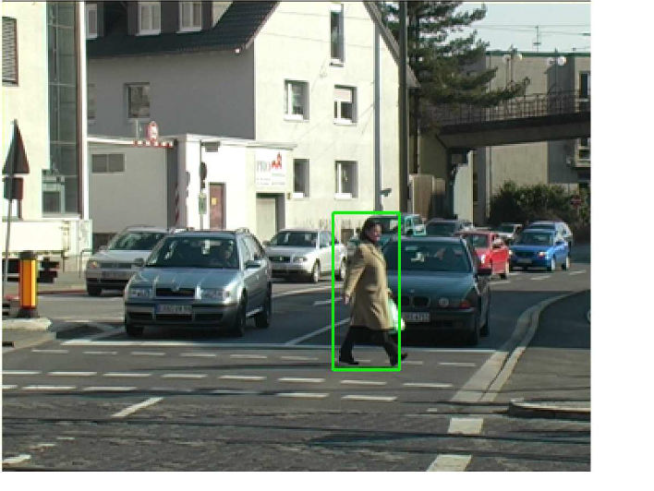
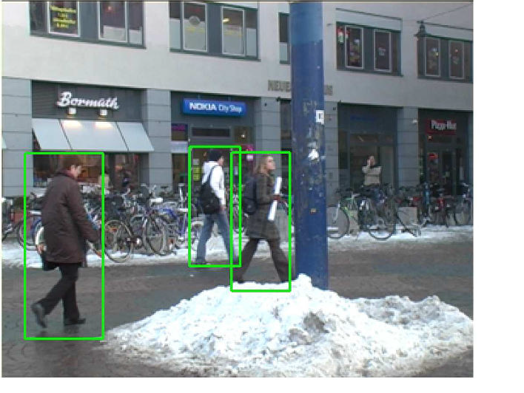
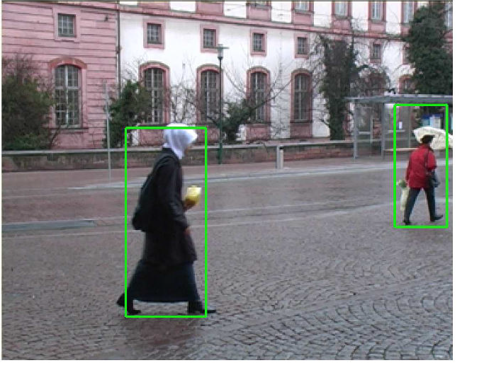
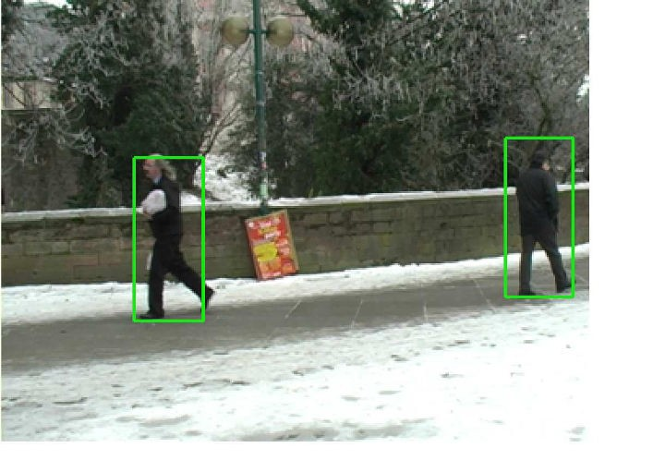
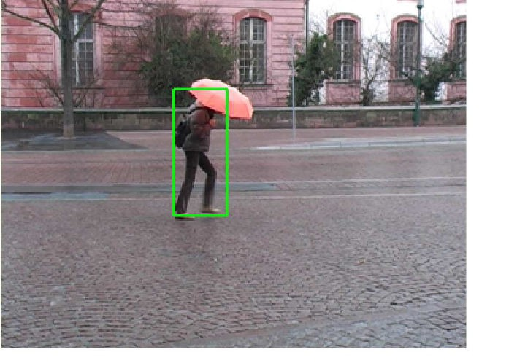
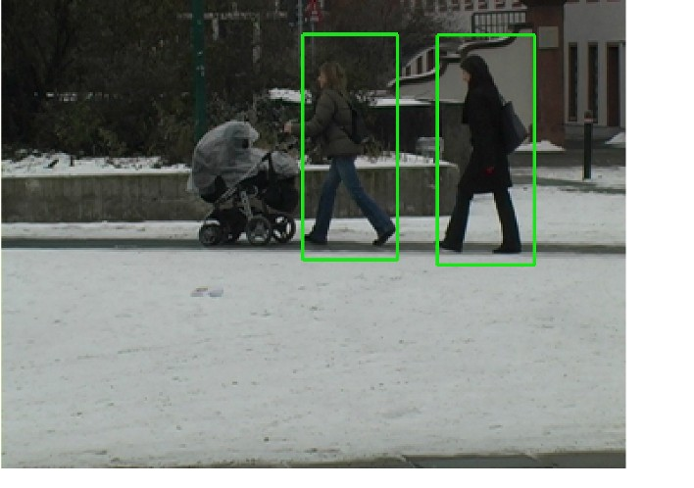
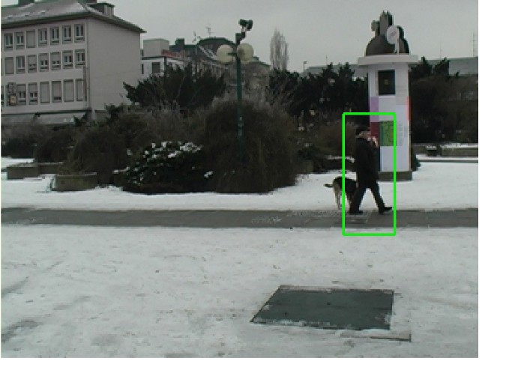
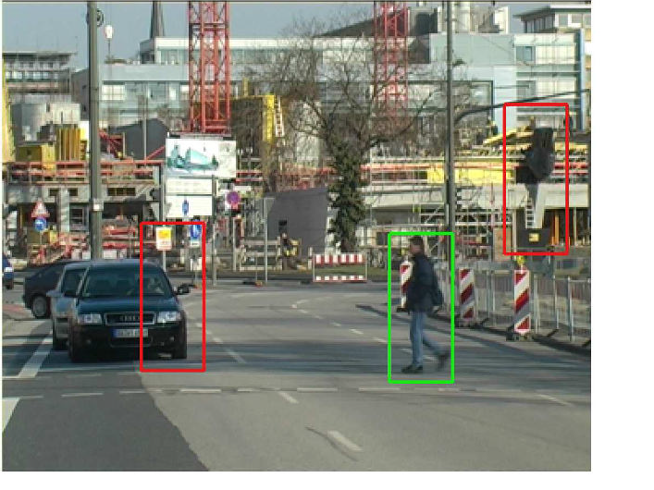
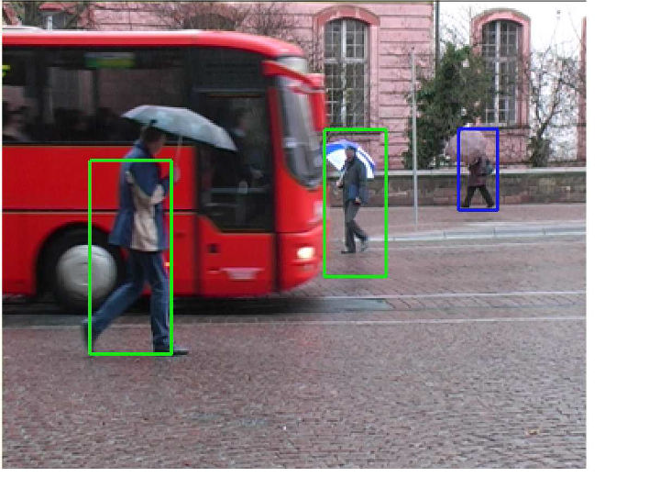
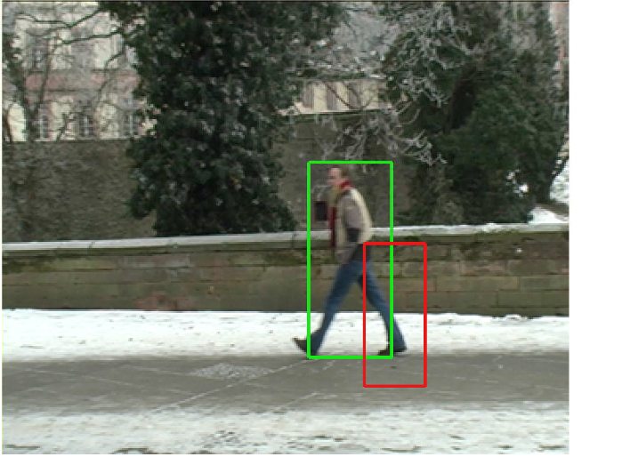
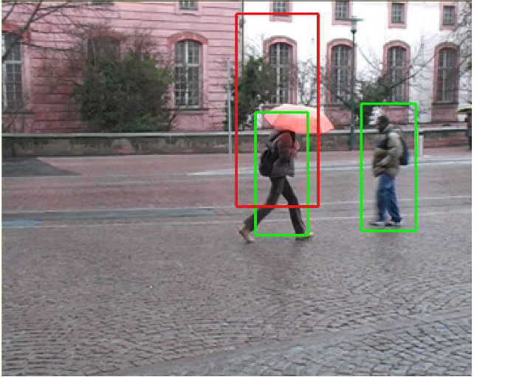
Object detection
Object Detection through Machine Learning

Slide 27
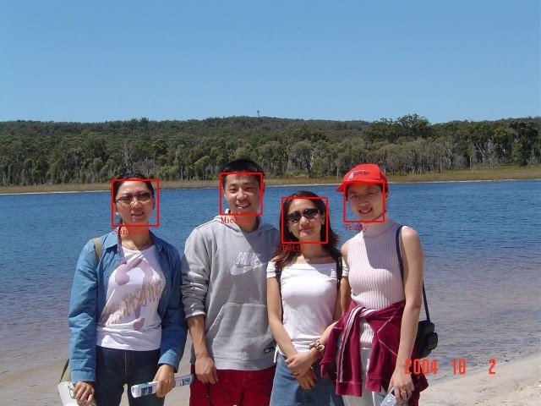
Face detection
discriminating human faces from non faces.

Slide 28

Gesture Recognition
Gesture Recognition through Machine Learning
http://www.nickgillian.com/archive/teaching/workshops/mitiap2013/IAP_Session1.pdf

Slide 29
SPAM Email Detection
Dear SIR,
I am Mr. John Coleman and my sister is Miss Rose Colemen, we are the children of late Chief Paul Colemen from Sierra Leone. I am writing you in absolute confidence primarily to seek your assistance to transfer our cash of twenty one Million Dollars ($21,000,000.00) now in the custody of a private Security trust firm in Europe the money is in trunk boxes deposited and declared as family valuables by my late father as a matter of fact the company does not know the content as money, although my father made them to under stand that the boxes belongs to his foreign partner.
…
Text Classification to Detect SPAM email

Slide 30

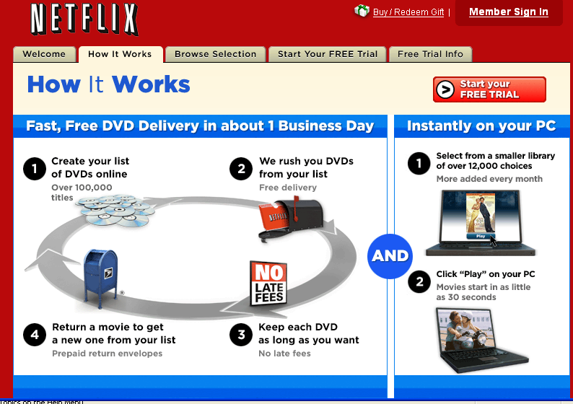
Recommender Systems
Users rate movies (1,2,3,4,5 stars);
Netflix makes suggestions to users based on previously rated movies.

Slide 31

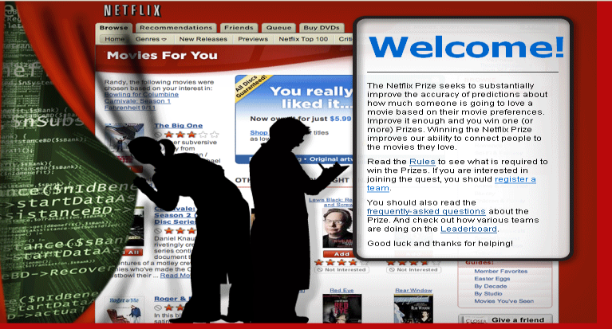
Recommender Systems
http://www.netflixprize.com/index
Since October 2006
“The Netflix Prize seeks to substantially improve the accuracy of
predictions about how much someone is going to love a movie
based on their movie preferences. Improve it enough and you win one
(or more) Prizes. Winning the Netflix Prize improves our ability to
connect people to the movies they love.”

Slide 32

http://www.netflixprize.com/index
Since October 2006
Supervised learning task
Training data is a set of users and ratings
(1,2,3,4,5 stars) those users gave to movies.
Construct a classifier that
given a user and an unrated movie,
correctly classifies that movie
as either 1, 2, 3, 4, or 5 stars
AT&T Research Won the Prize
$1 million prize for a 10% improvement over
Netflix’s current movie recommender/classifier
(MSE = 0.9514)

Slide 33
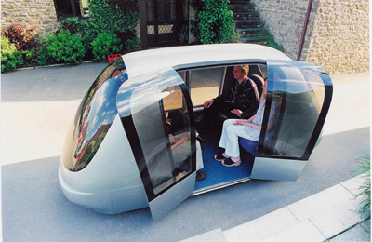
Driverless Car
An Artificial Neural Network is the brain of this driverless car

Slide 34
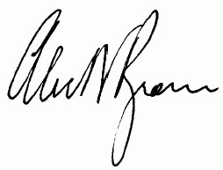
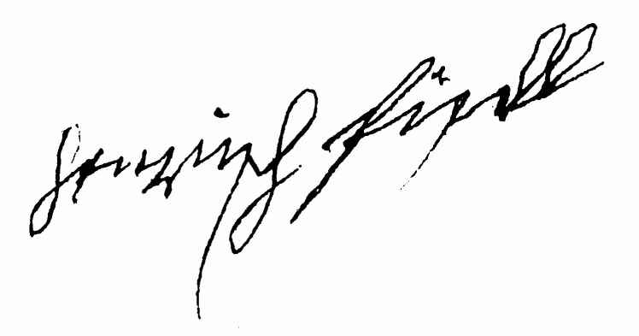
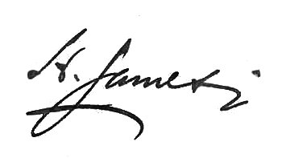
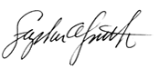
Signature recognition
Recognize signatures by structural similarities which are difficult to quantify.
does a signature belongs to a specific person, say Tony Blair, or not.

Slide 35
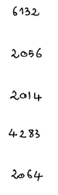
Character recognition (multi category)
Identify handwritten characters: classify each image of character into one of 10 categories ‘0’, ‘1’, ‘2’ …
6132
2056
2014
4283
2064

Slide 36
Machine Translation
Translate a document from one language to another.
60s, 70s: Systems based on grammatical rules and structures of individual languages.
80s – 2000: Statistical Machine Translation
2000+ : Deep Learning based on Artificial Neural Networks
https://translator.microsoft.com/neural/
Notes:
Try translating the following sentence with microsoft translator
This is a great course, assuming you want to learn!

Slide 37
More applications of data mining
Marketing
targeted marketing, cross-selling, up-selling, …
merchandizing, on-line recommendations
individualized advertising
Finance
Retail credit scoring ( ex: credit card companies )
Firm credit scoring/default prediction (e.g., by Moody’s, S&P)
modeling volatility for options pricing
trading strategies (e.g., for computer-driven hedge funds)
Fraud detection
almost every industry
esp. credit, telecom, healthcare, on-line retail
Customer relationship management
e.g., attrition/churn management
and many, many more ... (sports, ecommerce, …)

Slide 38
Why Mine Data?
There are now tremendous amounts of data that are automatically collected and warehoused. What are some examples?
Web data, e-commerce
Store purchases
Bank/Credit Card transactions
Cell phone GPS information
Facebook postings

Slide 39
Technological Changes helped
Computers: cheaper and more powerful
Disk and other storage: greater capacity and cheaper
RFID (radio frequency IDs), bar codes, and other sensors keep collecting data
Increased use of on-line resources and Internet
Cameras everywhere

Slide 40
Why Mine Data?
In business, competitive pressure is strong
Provide better, customized services for an edge (e.g. in Customer Relationship Management)
CRM is a relatively big deal now
How do we get the most out of the customer over the long run
Example: Customer Churn Analysis

Slide 41
What is data mining?
Data Mining is defined as the process of discovering patterns in data. The process must be (semi) automatic, and patterns discovered must lead to some advantage, usually, an economic advantage
A process for using information technology to extract useful (non-trivial, hopefully actionable) knowledge from large bodies of data

Slide 42
Types of Learning
Data Mining / Machine Learning
Supervised Learning
Unsupervised
Learning
Semi-supervised Learning
Reinforcement Learning
Course focus: Supervised and Unsupervised Learning

Slide 43
Data Mining Tasks
Supervised Learning ( Learn from Examples)
Classification (and class probability estimation)
Will this customer respond to our campaign?
Regression (“Numerical Estimation”)
How much will she use the service?
Affinity grouping (a.k.a. “associations”, “market-basket analysis”)
What items are commonly purchased together?
Clustering
Do my customers form natural groups?
Description/Profiling
What does “normal behavior” look like? (for example, as baseline to detect fraud)
Unsupervised Learning (No Examples to learn from)

Slide 44
Supervised vs. Unsupervised DM
Key (part 1): is there a specific, objective (binary or quantifiable) target that we are trying to predict?
Do my customers naturally fall into different groups?
[Unsupervised: no objective target stated.]
Do my customers fall into different groups with respect to their propensity to leave when their contracts expire?
[Supervised: would like to use the clasification to take action based on predicted likelihood of churn.]
Key (part 2): do we have data on this target?
supervised data mining requires both parts 1 & 2

Slide 45
Within supervised learning: classification vs. regression?
The difference is the type of target variable:
classification → categorical target*
regression → numeric target
* one twist: for business applications normally we want a numeric prediction over a categorical target variable. For example, say the target for our churn example is “customer leaves within 90 days of contract expiration”; we may want to model the probability that a customer leaves. This is still considered classification modeling rather than regression, because the underlying target variable (e.g., in historical data) is categorical. Sometimes this is called “class probability estimation”.

Slide 46
Course Outline
Data Mining / Machine Learning
Supervised Learning
Unsupervised
Learning
Classification
Regression
Clustering
Association Rules
Linear Regression
Nonlinear Regression

Slide 47
Building the Model and Using it
“Supervised” modeling:
Data
“Training” data have all values specified
New data item
Prediction of prob. of class
New data item has some value unknown (e.g., will she leave?)

Slide 48
Predictive model in use
Example
Using the Model
Prediction of prob. of class
New data item
What is the probability of attrition of this customer with characteristics X, Y, Z ?
P(C|X,Y,Z) = 0.85

Slide 49
Data mining is a process
science + craft + creativity + common sense
a process

Slide 50
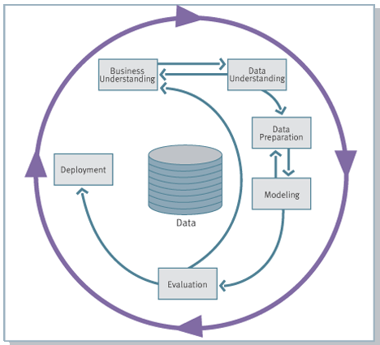
The CRISP Data Mining Process
Cross Industry Standard Process for Data Mining

Slide 51
The Data Mining Process

Slide 52
The Data Mining Process

Slide 53
End Lecture 1

Slide 54
What might a data mining model look like?
There are different sorts of data mining. Here are just two examples
Rules: (a supervised segmentation)
If (income > $70K) & (age > 40) & (domicile=“NE USA”) then prob(churn)=0.12
If … then …
Numeric function:
P(churn) = f(x1,x2,…, xk)

Slide 55
Data Mining versus …
Data Warehousing
Data warehouses coalesce data from across an enterprise, often from multiple transaction-processing systems, and also data from outside the enterprise
Analytical systems access DWs
Querying (SQL, QBE, other GUI-based querying)
Very flexible interface to ask factual questions about data
No modeling or sophisticated pattern finding
OLAP – On-line Analytical Processing
OLAP provides easy-to-use GUI to explore large data collections
Exploration is manual; no modeling
Dimensions of analysis preprogrammed into OLAP system
Traditional statistical analysis
Mainly based on hypothesis testing or estimation/quantification of uncertainty
Should be used to follow-up on data mining’s hypothesis generation
Automated statistical modeling (e.g., advanced regression)
This is data mining, one type -- usually based on linear models
Massive databases allow non-linear alternatives

Slide 56
What to use and When?
Who (exactly) are my most profitable customers?
Database querying
Do I have confidence that there really is a difference between them and the average customer?
Statistical hypothesis testing
But who really are these customers? Can I characterize them?
OLAP (manual search), Data mining (automated pattern finding)
Can we predict if a customer will leave us?
Data Mining

Slide 57
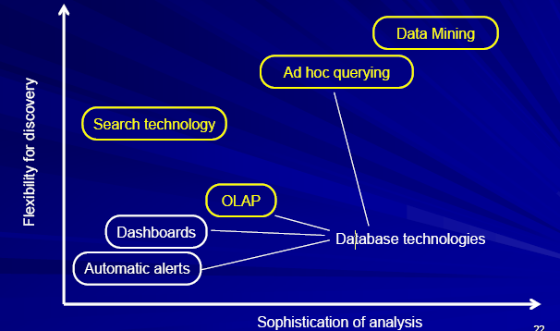
Data mining in the spectrum of business data technologies

Slide 58
Why data mining is becoming so popular?
Firms are collecting massive amounts of data on operations, customers, and the competitive landscape
These data can be an asset from which to draw competitive advantage
But, there is far too much data for manual analysis
Amazon records purchase behavior for >50M active customers
Phone companies keep info on 100’s of millions of accounts (each with thousands of transactions)
Google stores information on 11B objects
Walmart estimates that it has ~500 TB of data collected (that’s 4,000,000,000,000,000 bits or ½ billion books or >10 Libraries of Congress)
This will be peanuts once RFIDs become ubiquitous

Slide 59
ML in a Nutshell
Tens of thousands of machine learning algorithms
Hundreds new every year
Every machine learning algorithm has three components:
Representation
Evaluation
Optimization

Slide 60
Representation
Decision trees
Sets of rules / Logic programs
Instances
Graphical models (Bayes/Markov nets)
Neural networks
Support vector machines
Model ensembles
Etc.

Slide 61
Evaluation
Accuracy
Precision and recall
Squared error
Likelihood
Posterior probability
Cost / Utility
Margin
Entropy
K-L divergence
Etc.

Slide 62
Optimization
Combinatorial optimization
E.g.: Greedy search
Convex optimization
E.g.: Gradient descent
Constrained optimization
E.g.: Linear programming

Slide 63
Types of Learning
Supervised (inductive) learning
Training data includes desired outputs
Unsupervised learning
Training data does not include desired outputs
Semi-supervised learning
Training data includes a few desired outputs
Reinforcement learning
Rewards from sequence of actions

Slide 64
Customer discovery
predict whether a customer is likely to purchase certain goods according to a database of customer profiles and their history of shopping activities.
Used for Up sell, Cross sell

